Slide 1
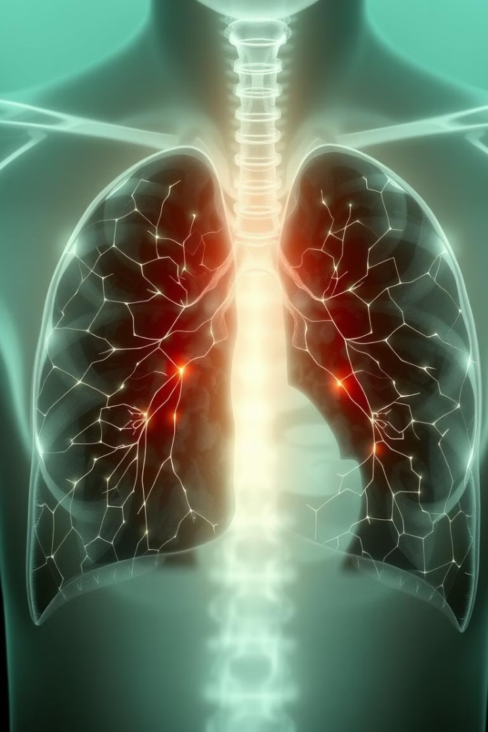

VER-Net: Hybrid Transfer Learning for Lung Cancer Detection
Lung cancer is a leading cause of death worldwide. Early detection is crucial for effective treatment. This presentation explores VER-Net, a novel transfer learning model for lung cancer detection using CT scan images. VER-Net combines multiple transfer learning models to improve accuracy and efficiency in identifying lung cancer.
by Tanisha Wake

Slide 2

Introduction to Lung Cancer Detection
Global Impact
Risk Factors
Lung cancer is the second most common cancer globally, with over two million new cases per year. It has the highest mortality rate among all cancers, contributing significantly to cancer-related deaths worldwide.
Tobacco usage, high body mass index, alcohol consumption, inadequate consumption of fruits and vegetables, and a lack of physical activity are major risk factors. Early detection and effective treatment are crucial for improving survival rates.

Slide 3

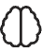

The Role of Deep Learning and Transfer Learning
Deep Learning
Transfer Learning
Deep learning techniques, especially Convolutional Neural Networks (CNNs), have become increasingly popular in analyzing medical images. CNNs can automatically discover high-dimensional features, improving image identification and feature extraction.
Transfer learning leverages pre-trained models to enhance the performance of deep learning models. It offers a practical way to use existing knowledge and resources to develop accurate and efficient models for lung cancer detection.

Slide 4

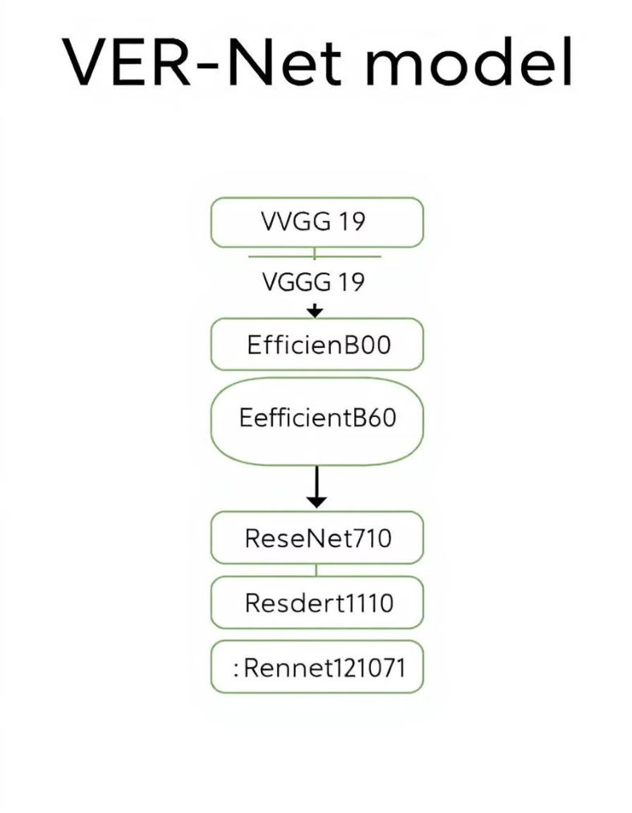
VER-Net: A Novel Transfer Learning Model
Stacking Models
Image Processing
VER-Net stacks three different transfer learning models (VGG19, EfficientNetB0, and ResNet101) to detect lung cancer using lung CT scan images. This hybrid approach enhances prediction capabilities.
The model incorporates image preprocessing, data augmentation, and hyperparameter tuning to improve efficacy. The original image dataset is resized to 460x460x3.
Performance
Experimental results show that VER-Net outperforms other transfer learning models, achieving high accuracy, precision, recall, and F1-score. It is effective for lung cancer detection and potentially useful for other diseases with CT scan images.

Slide 5
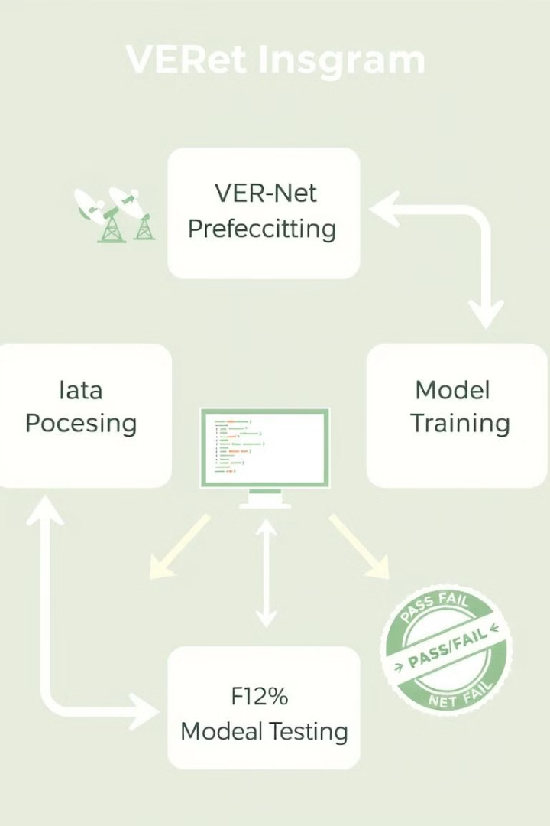




Research Methodology: Framework
Image Acquisition
Chest CT scan images are acquired from datasets like Kaggle.
Preprocessing & Augmentation
Images are preprocessed and augmented to enhance suitability for the experiment.
Model Building
Top three transfer learning models are selected and stacked to build a new prediction model.
Training & Validation
The model is trained and validated to classify three cancer classes and a normal class.

Slide 6
Dataset Description and Preprocessing
Dataset
Preprocessing
The dataset contains CT scan images of Adenocarcinoma, Large cell carcinoma, and Squamous cell carcinoma. It consists of 1653 CT images, with 1066 for training, 446 for testing, and 141 for validation.
Data preprocessing involves image resizing and data augmentation. Images are resized to 460x460, and random oversampling is applied to balance the dataset. Data augmentation includes shear range, zoom range, and flipping.

Slide 7




Transfer Learning Models Used in VER-Net
VGG19
EfficientNetB0
ResNet101
VER-Net combines VGG19, EfficientNetB0, and ResNet101. VGG19 has a simple architecture and good performance. EfficientNetB0 balances accuracy and efficiency. ResNet101 uses residual connections to mitigate the vanishing gradient problem, allowing deeper network architecture without compromising performance.

Slide 8



VER-Net Model Architecture and Parameters
Output Classes
2
Four (Adenocarcinoma, Large cell carcinoma, Squamous cell carcinoma, Normal)
Input Shape
1
460x460x3
Dense Layers
3
Three dense layers for three stacked transfer learning models
The architecture maps the input shape to four classes as output. The model uses three different dense layers for the stacked transfer learning models. Key hyperparameters include Adam and RMSprop optimizers, a learning rate of 0.001, and categorical cross-entropy loss function.

Slide 9
Experimental Results and Performance Analysis
Accuracy & Loss
Comparison
VER-Net achieved the highest testing accuracy of 91% and the lowest testing loss of 0.34%. Both accuracy and loss for validation/testing converge approximately after 20 epochs, indicating effective training without significant underfitting or overfitting.
VER-Net outperformed other models in precision, recall, and F1-score. It also showed lower variations across classes, suggesting balanced effectiveness. Compared to recent literature, VER-Net demonstrates competitive accuracy in lung cancer detection.

Slide 10
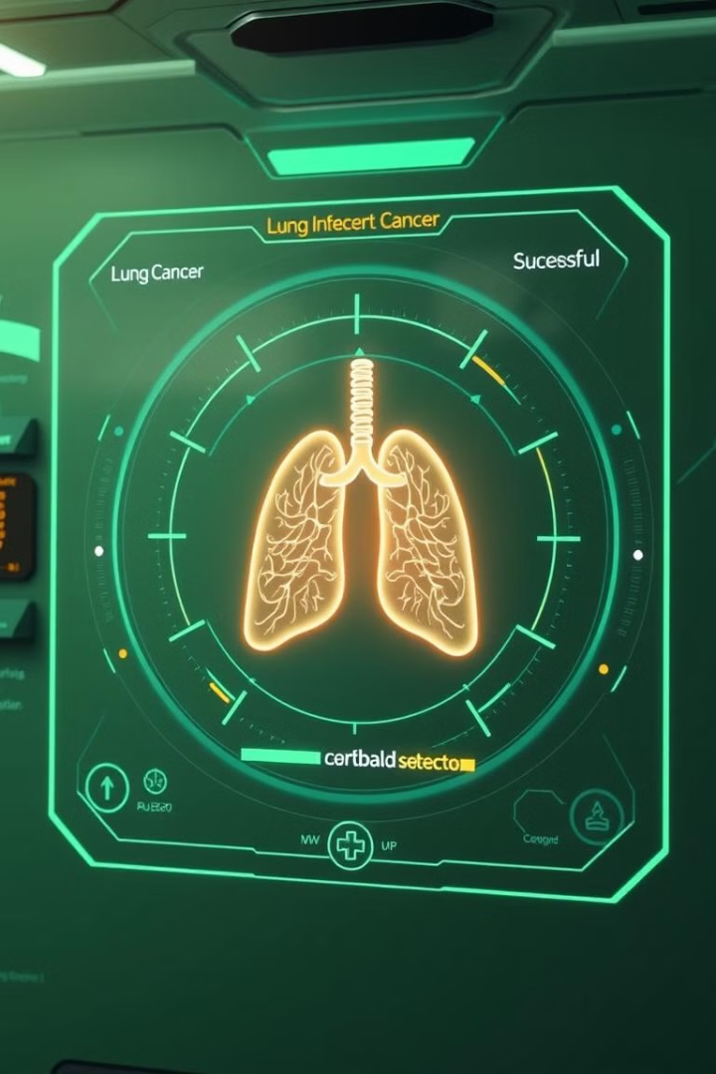
Conclusions and Future Scope
Conclusion
VER-Net, an ensembled model, effectively detects lung cancer using CT scan images. It outperforms other transfer learning models and exhibits better accuracy than similar empirical studies.
Future Work
Future work includes experimenting with different model combinations, applying VER-Net to chest X-ray images, assessing lung cancer severity, and extending the model to other diseases with CT scan images.

